Slide 1
Team 4 Presentation CS633
Aleksandra Trendafilova
Guy O’Neal
Waseem Awan
Marvin Brown
6/21/15

Slide 2
Project Scope
The Loans & Grants website is a specialized web site focused on providing loan and grant information for businesses and entrepreneurs via interactive search tools and intuitive user design. The website uses the Small Business Administration database and its Web APi by providing keywords or different criteria such as industry, loan type and more.

Slide 3
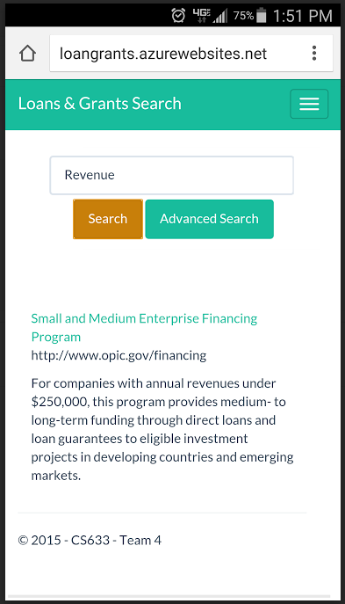
System Infrastructure
Cloud Based Architecture
Azure Platform
Availability – 24x7
Scalable – Infrastructure Expansion is
easy and quick
Cost Effective – No upfront cost;
Rent as you grow
Secure Infrastructure
Mobile friendly
Targets the grow number of mobile device users

Slide 4
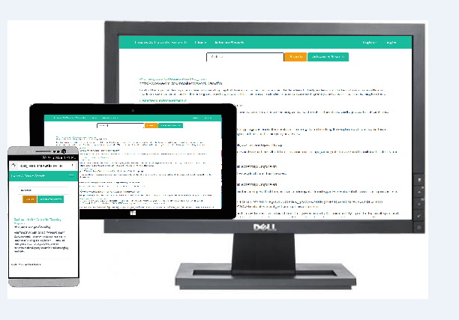

Slide 5
Team Composition and Collaboration Tools
Team Composition
Team Lead – Aleksandra Trendafilova
Senior developer – Waseem Awan
Usability lead – Marvin Brown
Test expert – Guy O’Neal
Collaboration Tools
GitHub
Pivotal Tracker
Google + Hangouts
Emails
Phone

Slide 6
Personas and Requirements
Public User
Registered User
Super User
Support User
Web API
As a public user, I want to be able to register for an account, so I can save my personal information and searches. Register for an account
As a registered user, I want to be able to log into my account, so I can look up my personal information and searches. Logging into an account
As a public user, I want to be able to search for loans and grants, so that I can find financing for my project. Searching for loans and grants
As a public or registered user, I would like to be able to apply advance search filters, so I can easily find the information I am looking for. Advance Searching

Slide 7
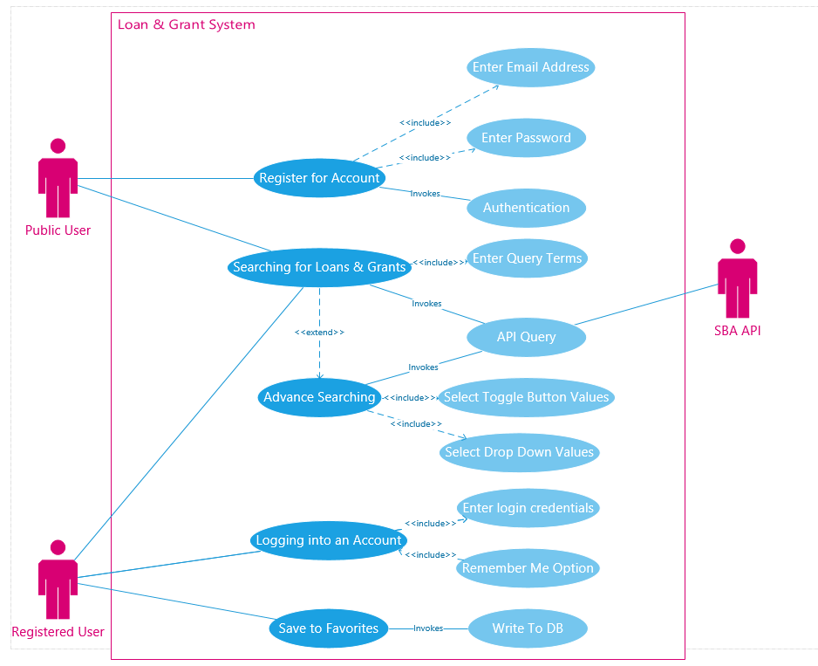
Use cases

Slide 8
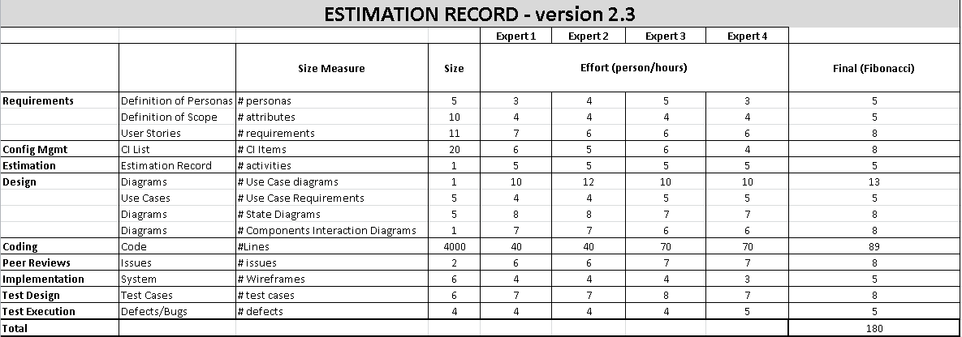
Estimation Record

Slide 9
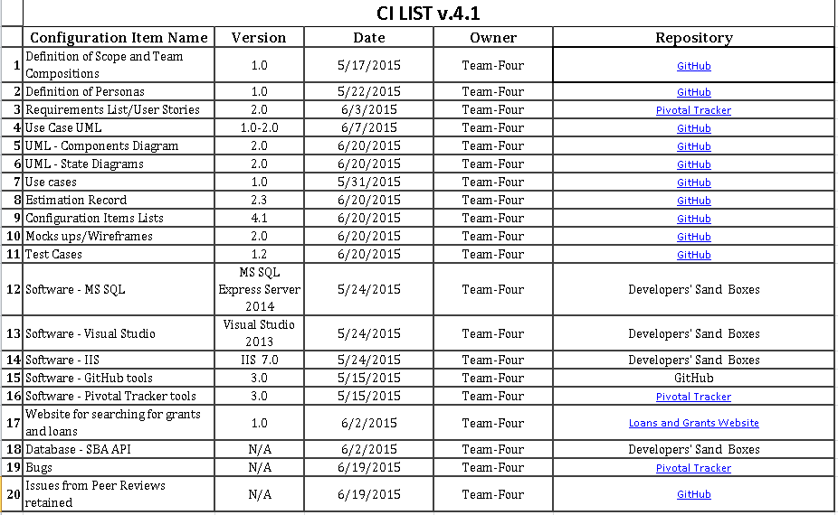
Configuration Items List

Slide 10
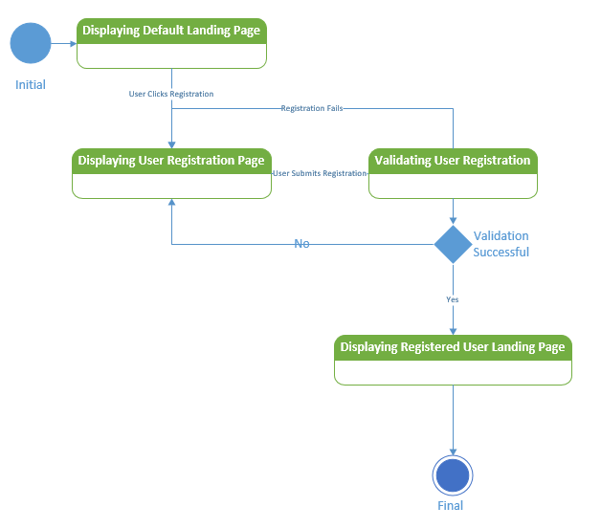
State Transition Diagrams
001 Registration_v2.0

Slide 11
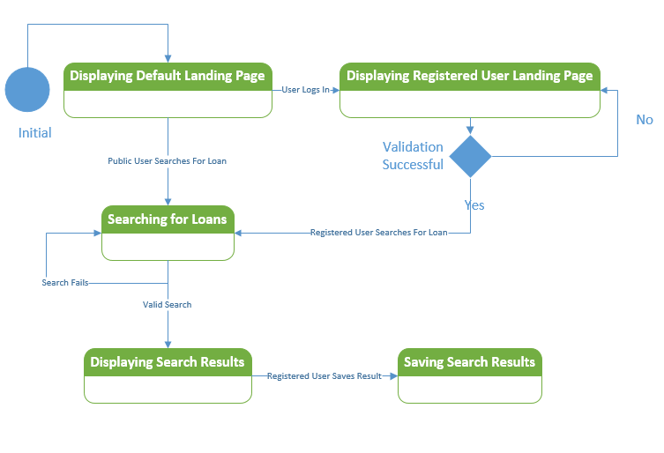
State Transition Diagrams
002 Search for Loans and Grants _v2.0

Slide 12
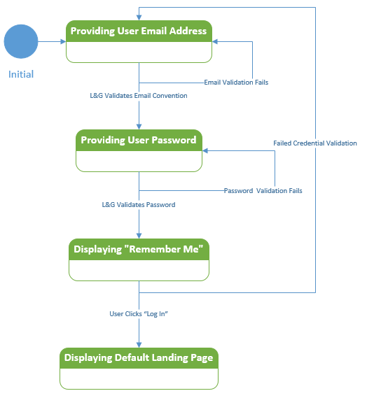
State Transition Diagrams
004 Logging into an Account_v2.0

Slide 13
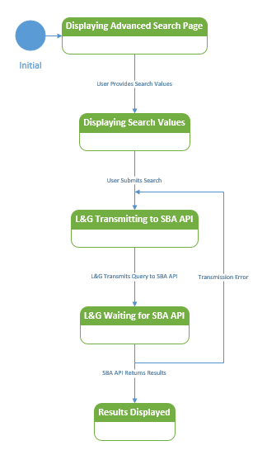
State Transition Diagrams
005 Advance Search_v2.0

Slide 14
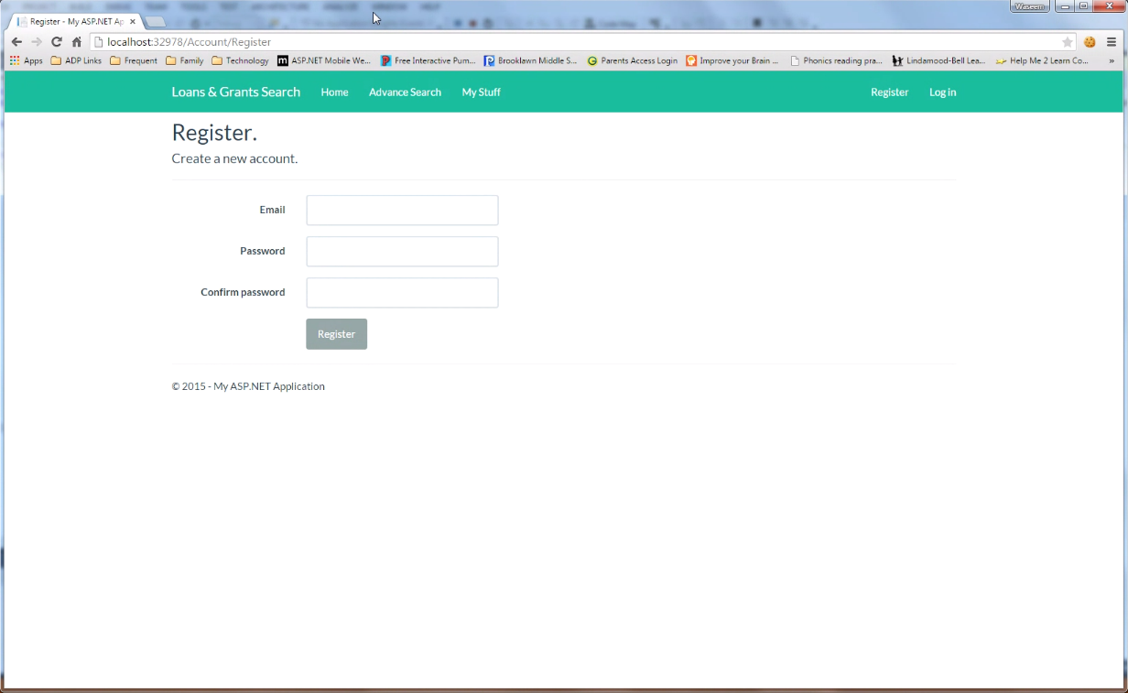
Wireframes – Register Page

Slide 15
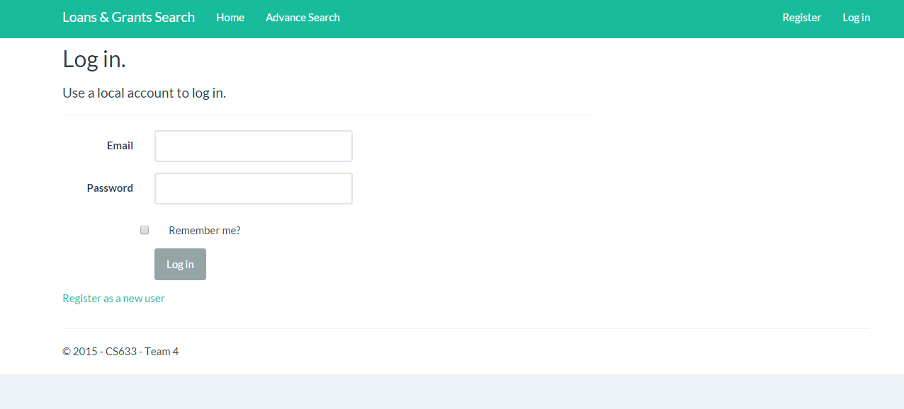
Wireframes – Log in Page

Slide 16
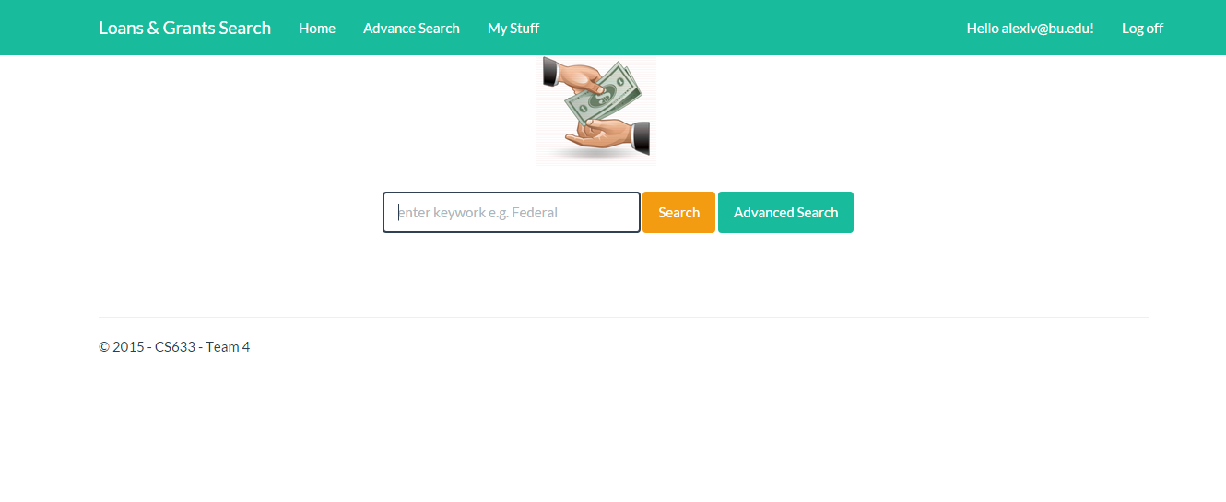
Wireframes – Login Landing Page

Slide 17
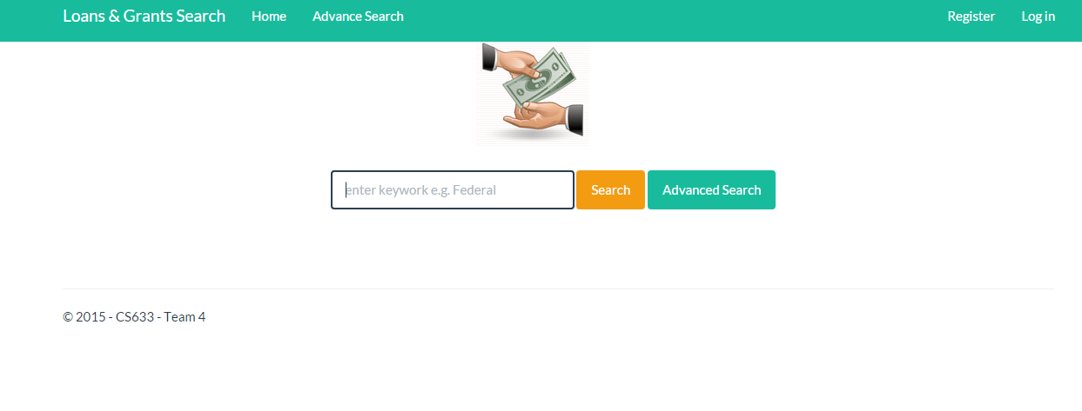
Wireframes – Search Page

Slide 18
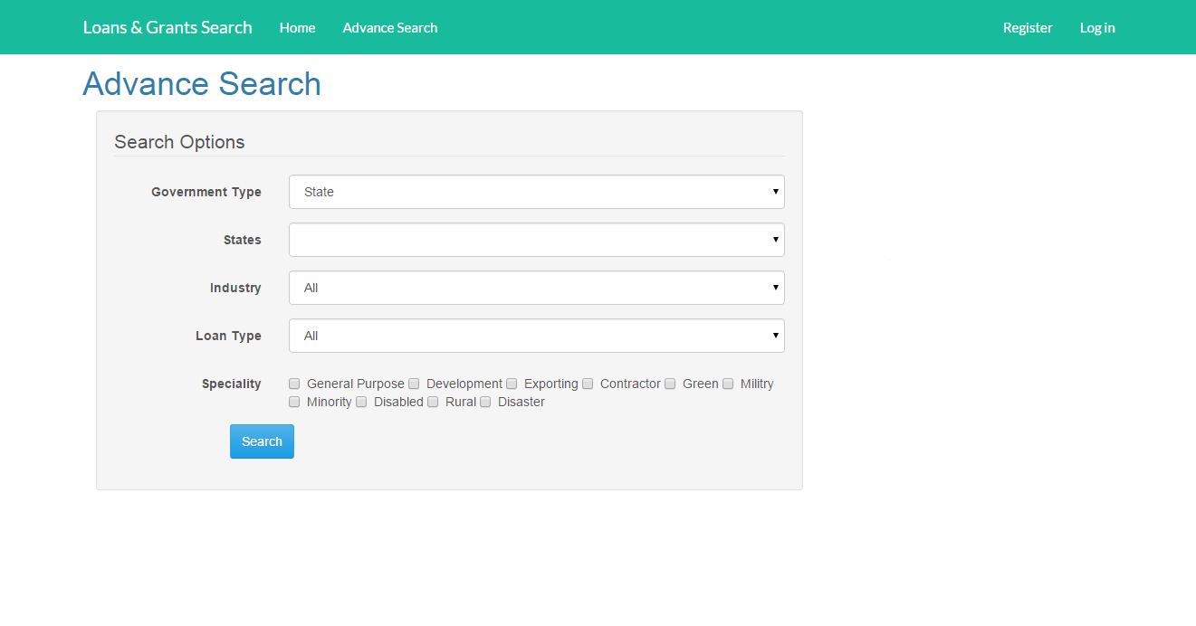
Wireframes – Advance Search Page

Slide 19
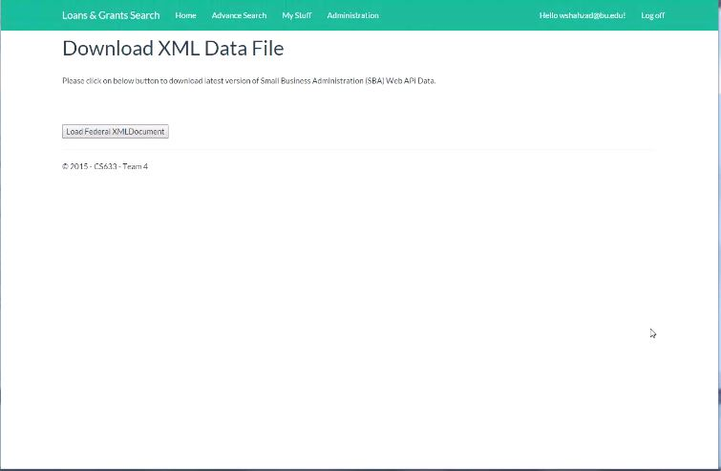
Wireframes – Admin Page

Slide 20
Test Cases
001_Loans & Grant Simple Search Test_v1.2
Verify that user is able to provide simple search criteria to Loan & Grant system and then submit the same to the SBA API.
002_Register Screen Test_v1.2
Verify that the user is able to register within the Loan & Grant system by creating an Account.
003_Account Login Invalid Password Test_v1.2
Verify that in the event a user provides an invalid password the system rejects the authentication.
004_Registration Email Uniqueness Test_v1.0
Verify that email addresses will only be registered to one user.
005_Valid User Credentials Test_v1.0
Registered user is logged into account upon successful authentication.
006_Account Login Invalid Username Test_v1.0
Verify that in the event a user provides an invalid username the system rejects the authentication.

Slide 21
Loans and Grants Website DEMO

